Slide 1

Construction of a Modern Pop Album
Jenny Eberling

Slide 2
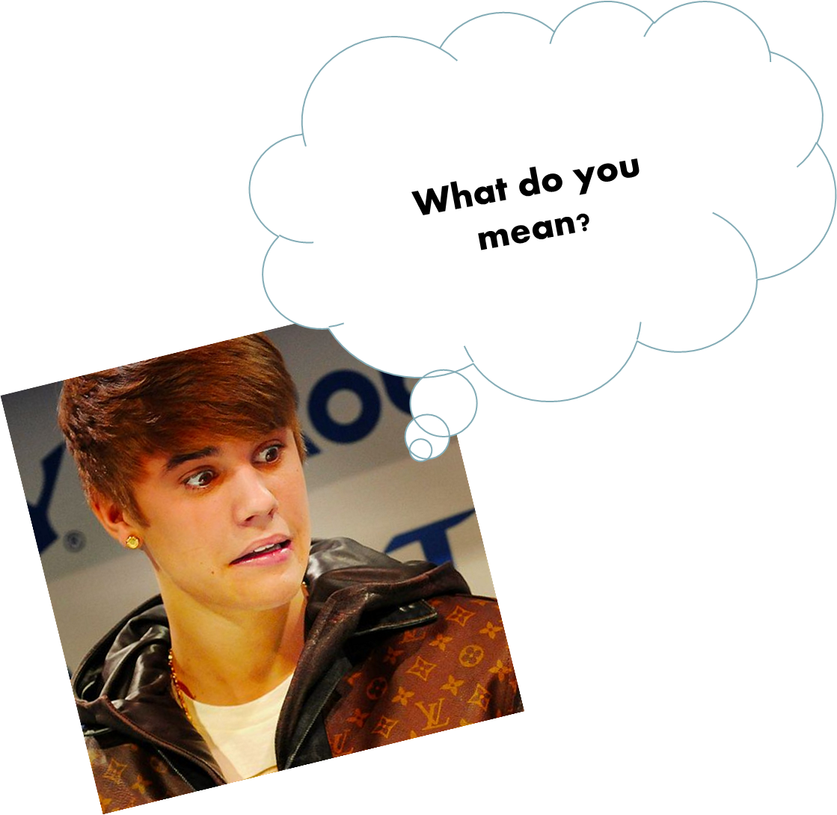
Introduction
Concepts
Album flow
EP vs album
Big Questions
What emotions do successful albums tap into?
How do the three stages of an album differ?
“thirds” calculated with “track_placement”
(Track Number – .5)
Album Length

Slide 3
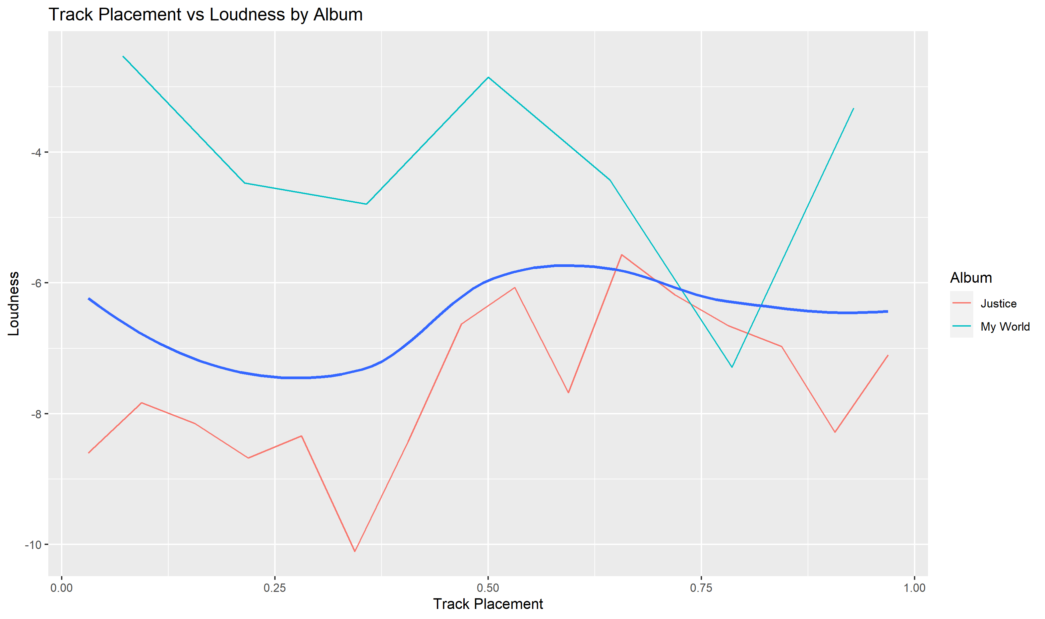

Slide 4

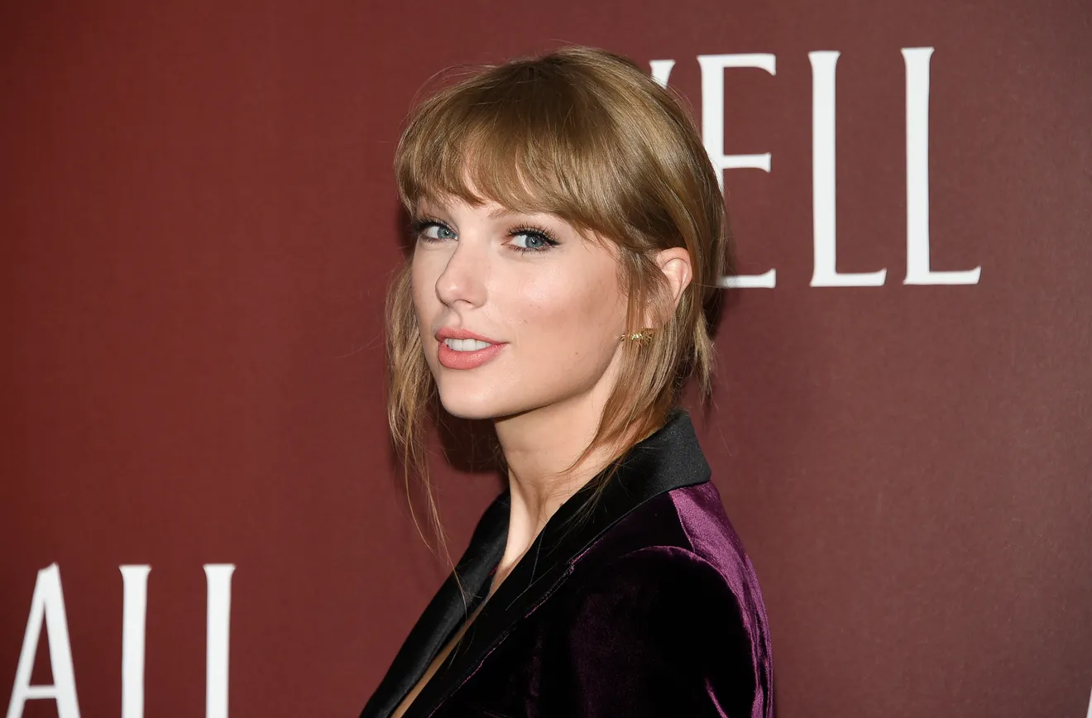
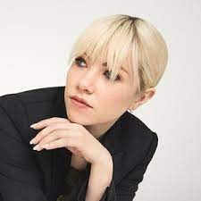
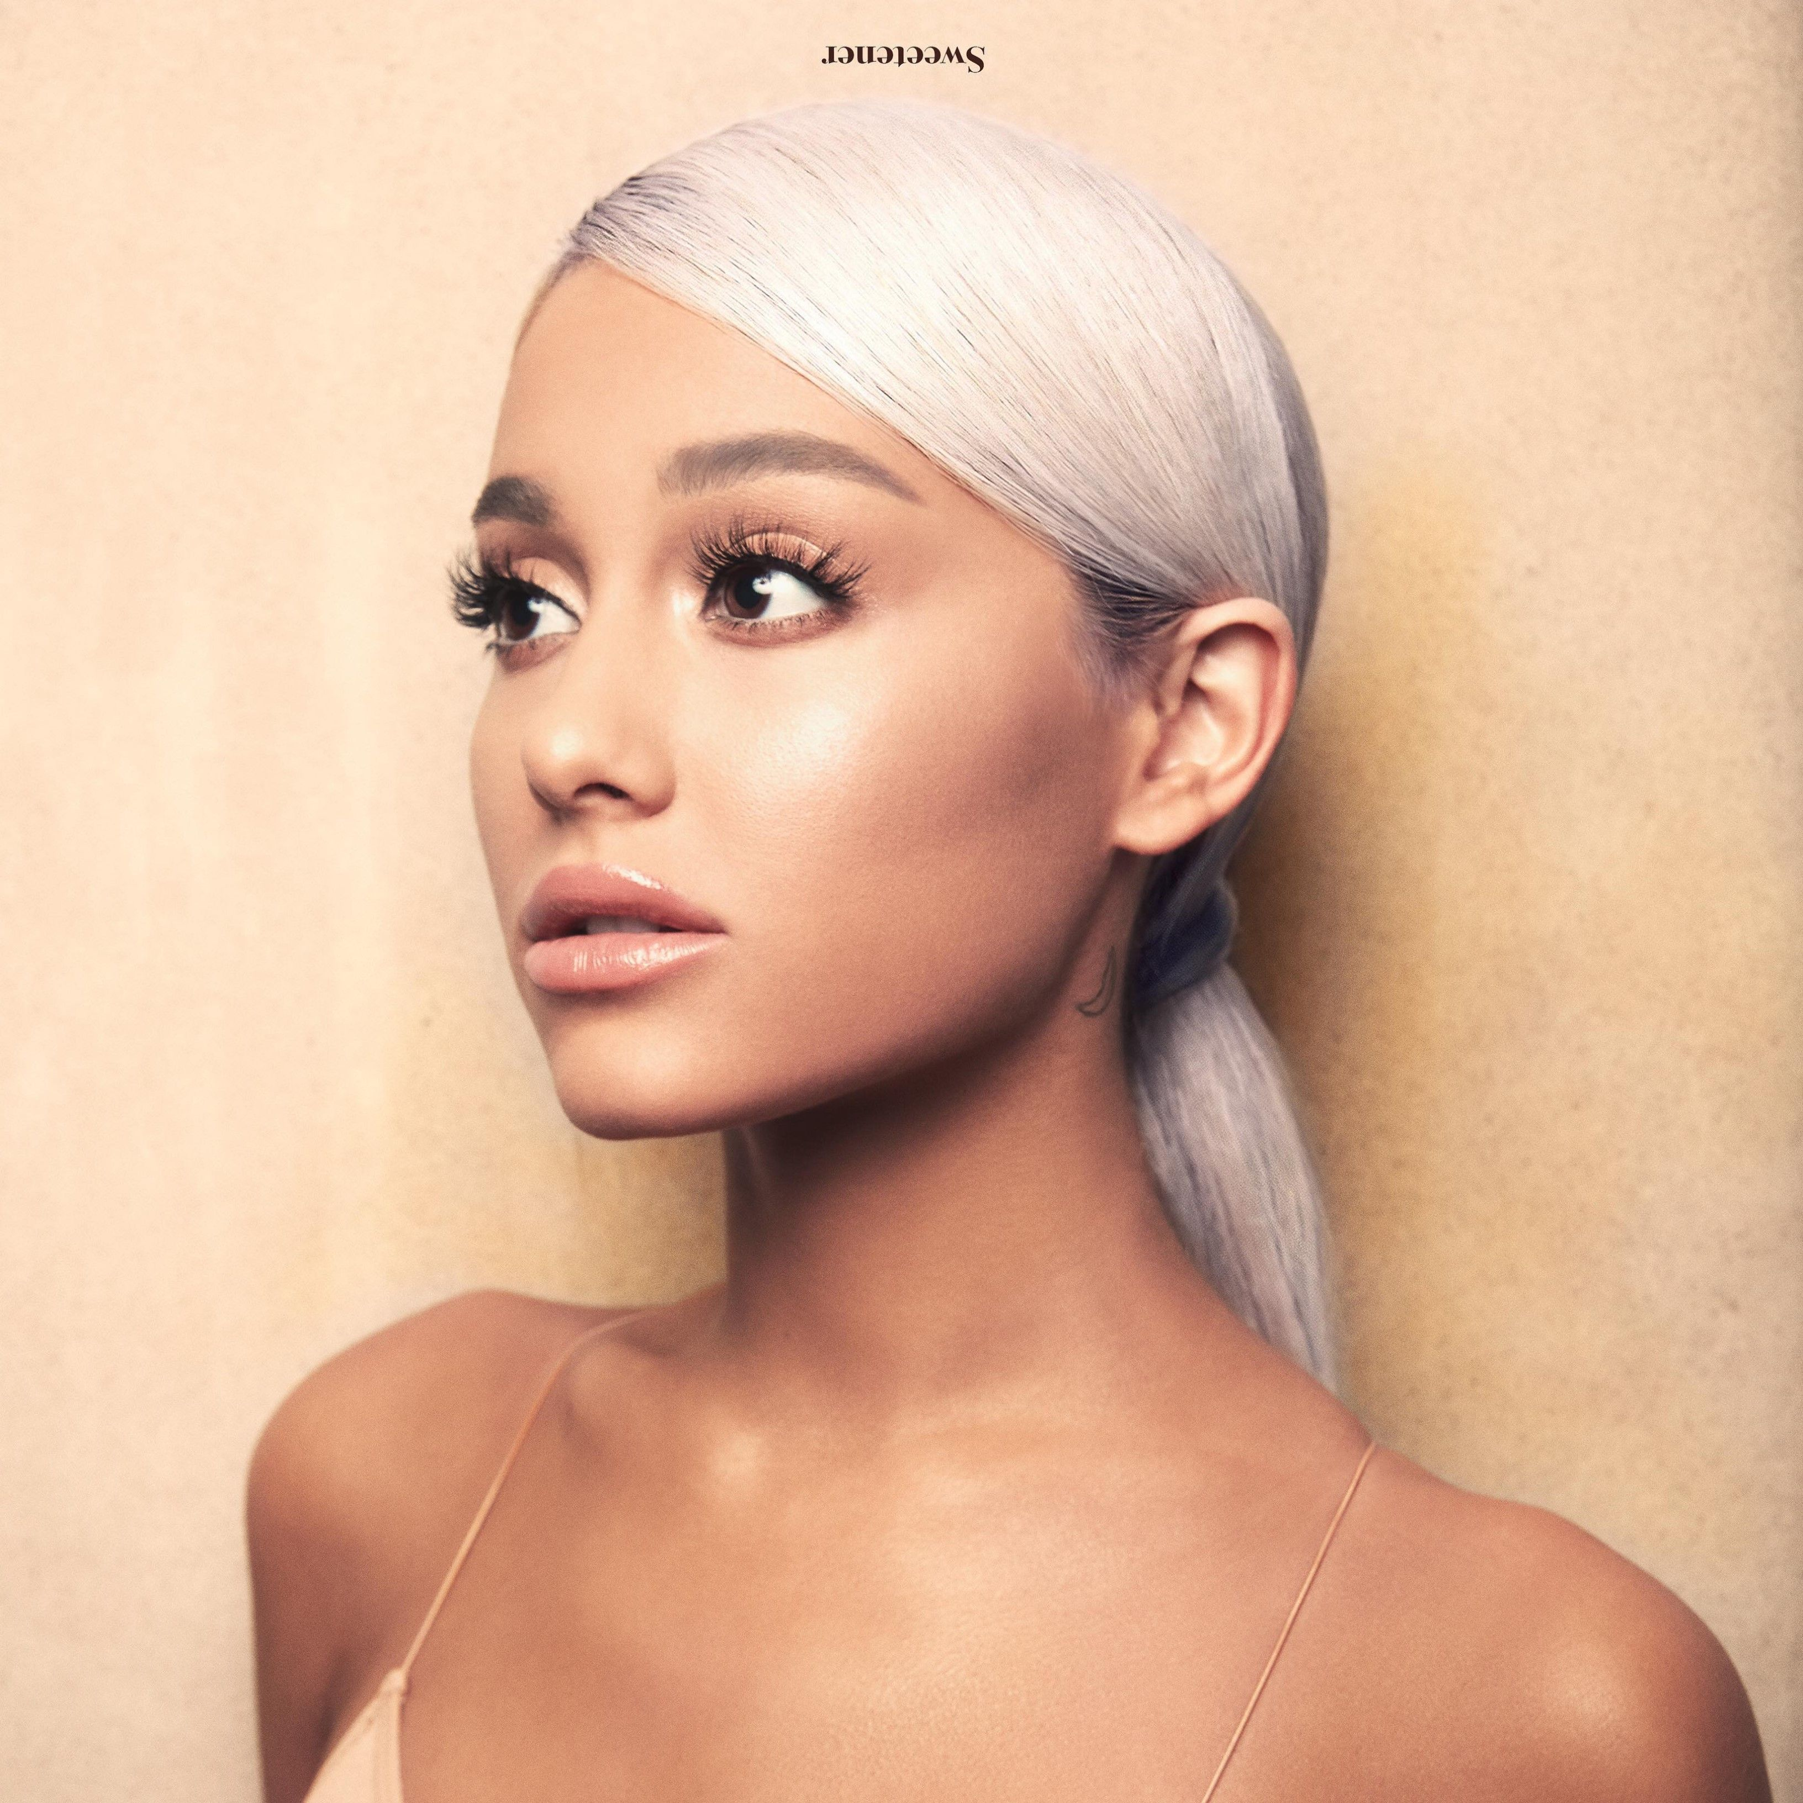
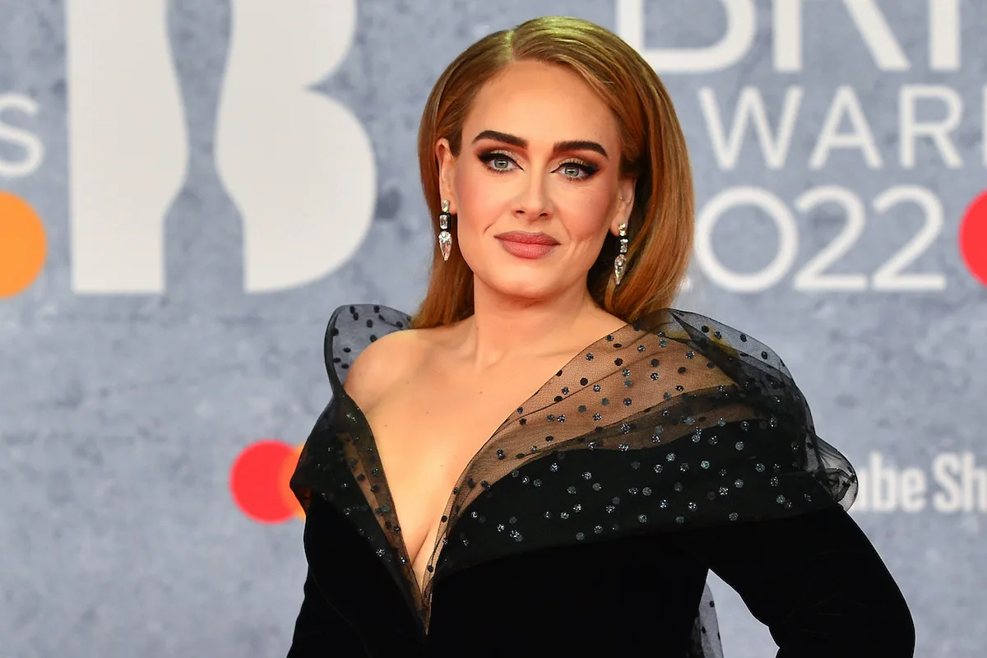
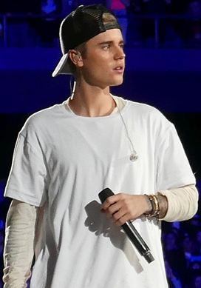
Data
Spotify
6 Artists
35 Albums, 460 songs
Original Albums (no bonus tracks, no re-recordings, no live)
6 AOTY from 3 Artists

Slide 5
Data
Spotify
6 Artists
35 Albums, 460 songs
Original Albums (no bonus tracks, no re-recordings, no live)
6 AOTY from 3 Artists

Slide 6

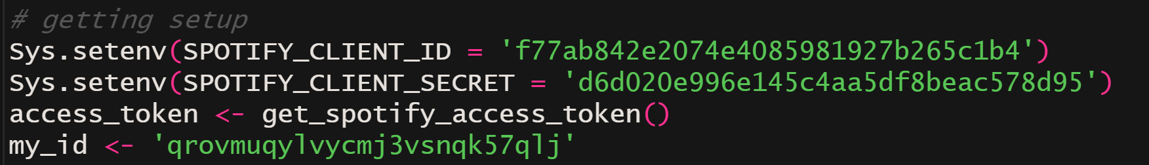

Slide 7
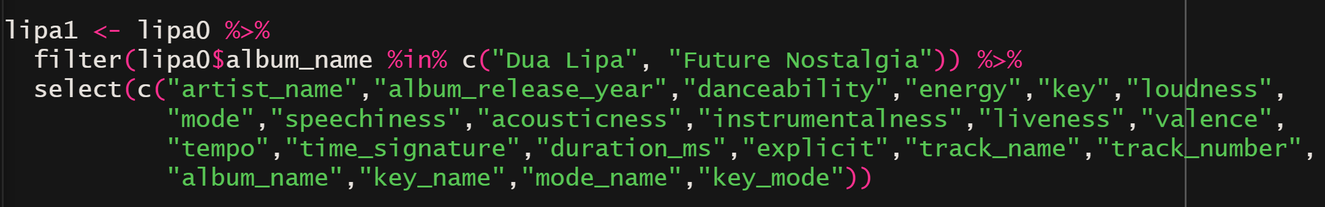

Get audio features
Select “Albums” only
Grab Variables
Group by track, filter duplicates
Manually filter live/duplicate songs
Be careful! Check Album totals!
Calculate
Duration (min)
Track_placement
Third and third indicator
AOTY
Album Name (short)

Slide 8
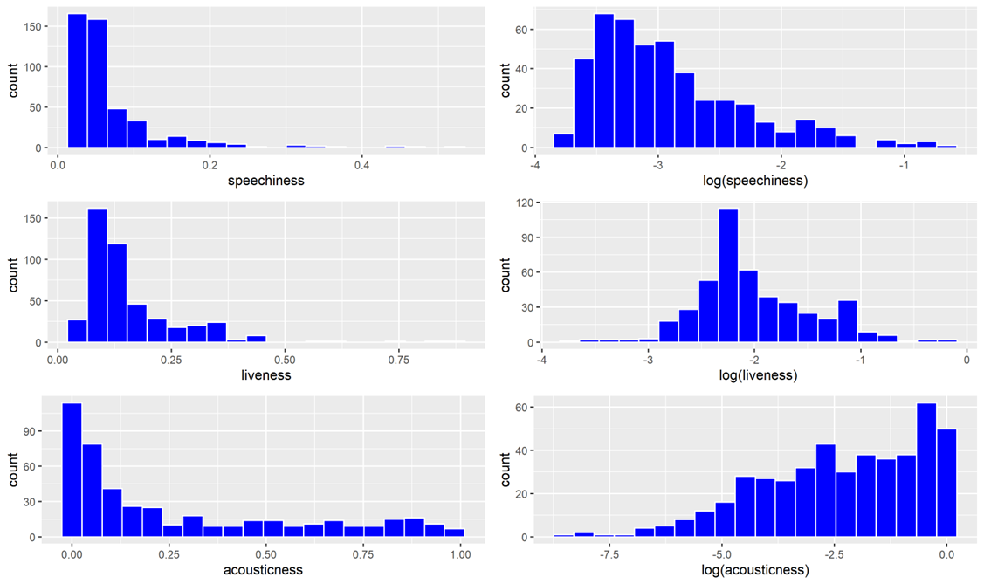

Slide 9
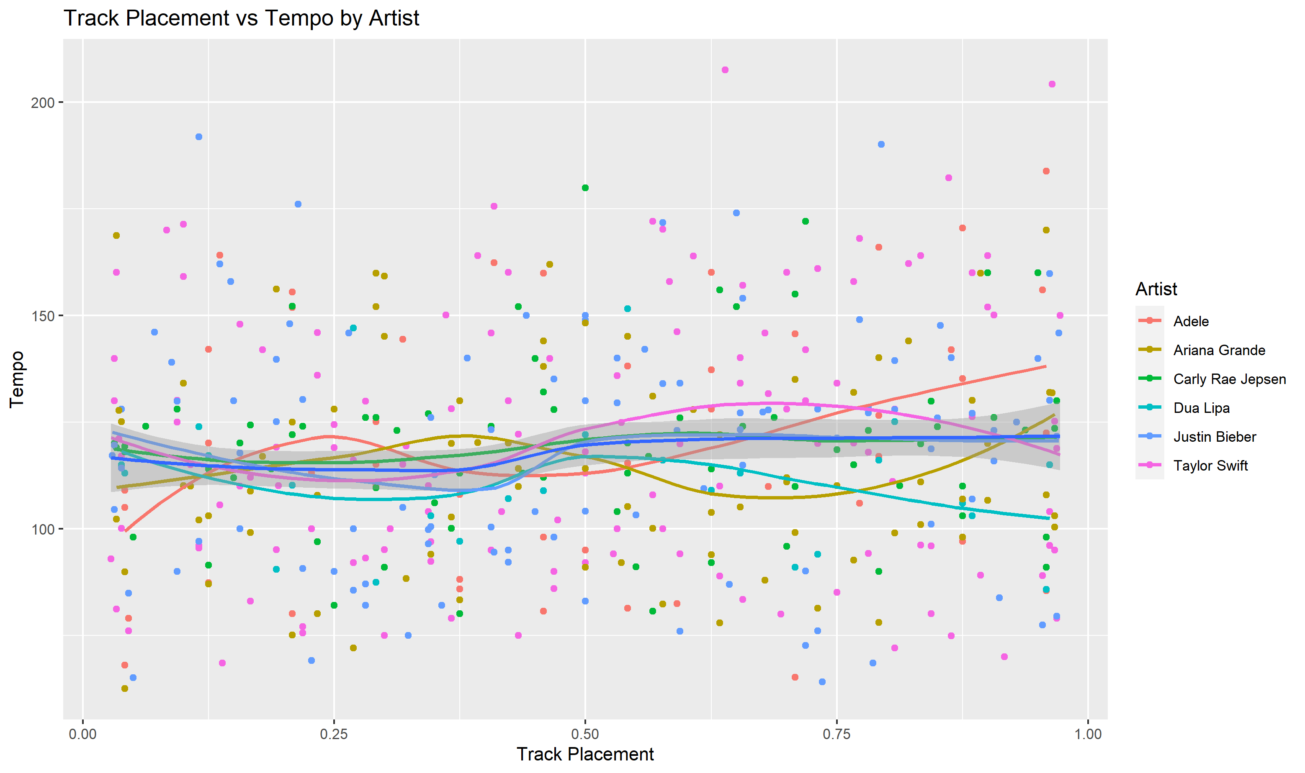

Slide 10
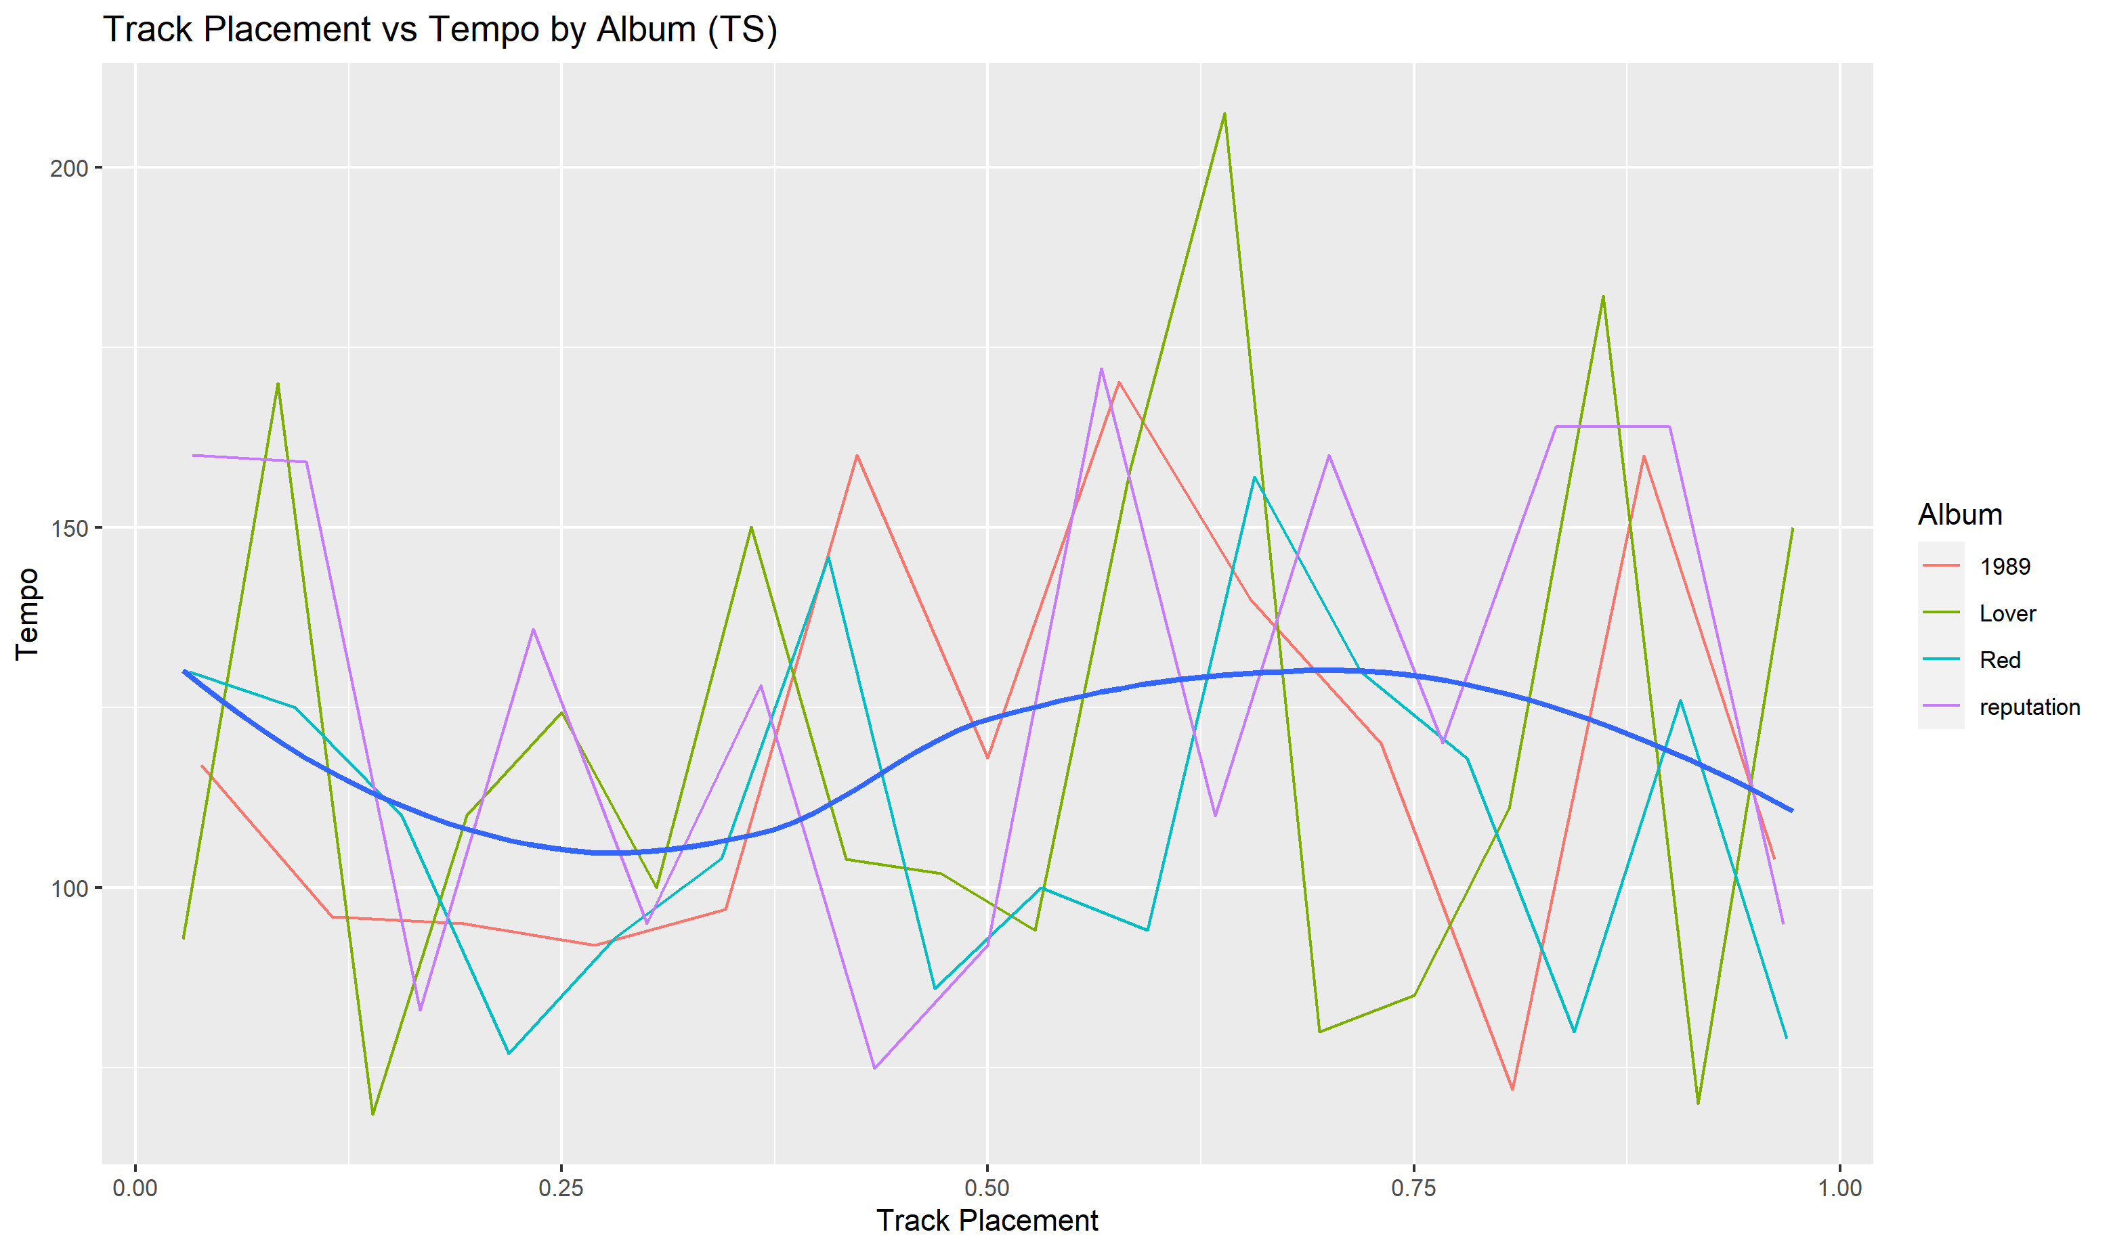

Slide 11
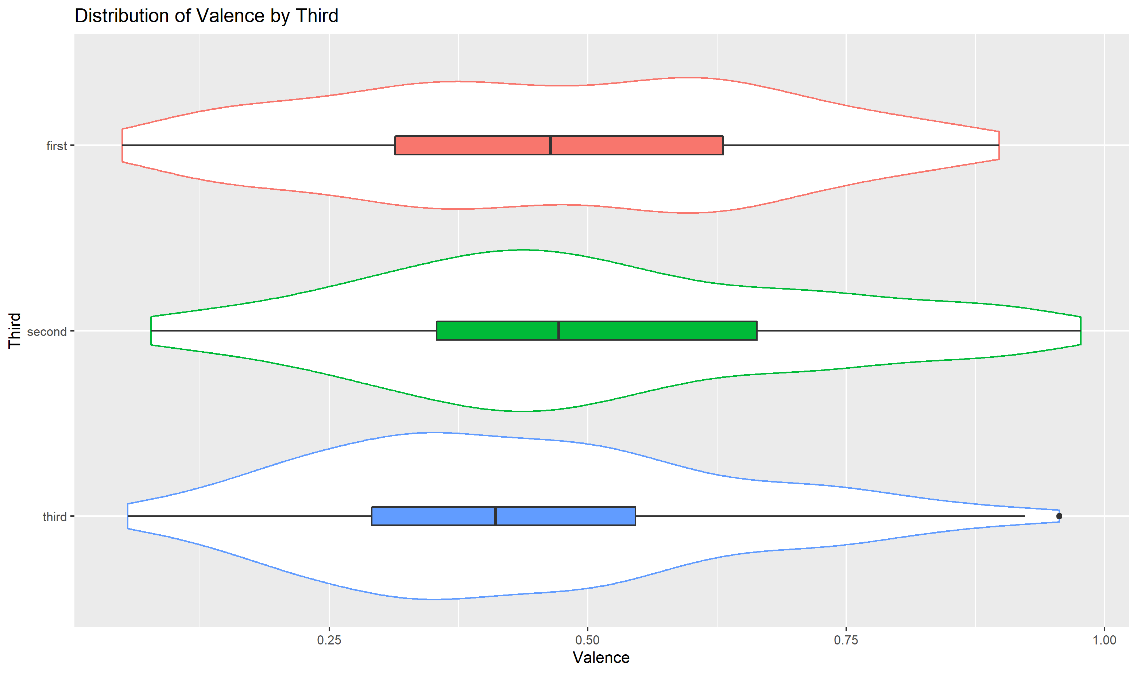

Slide 12
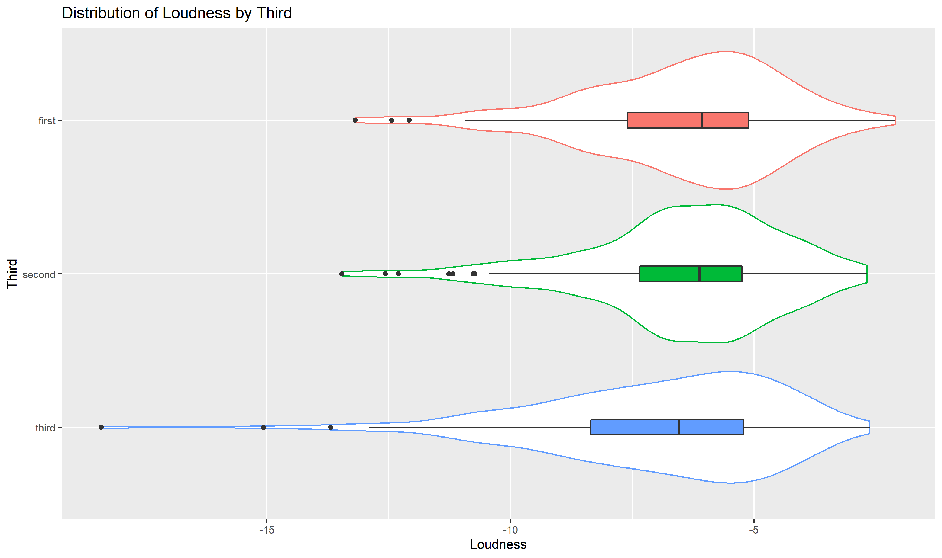

Slide 13
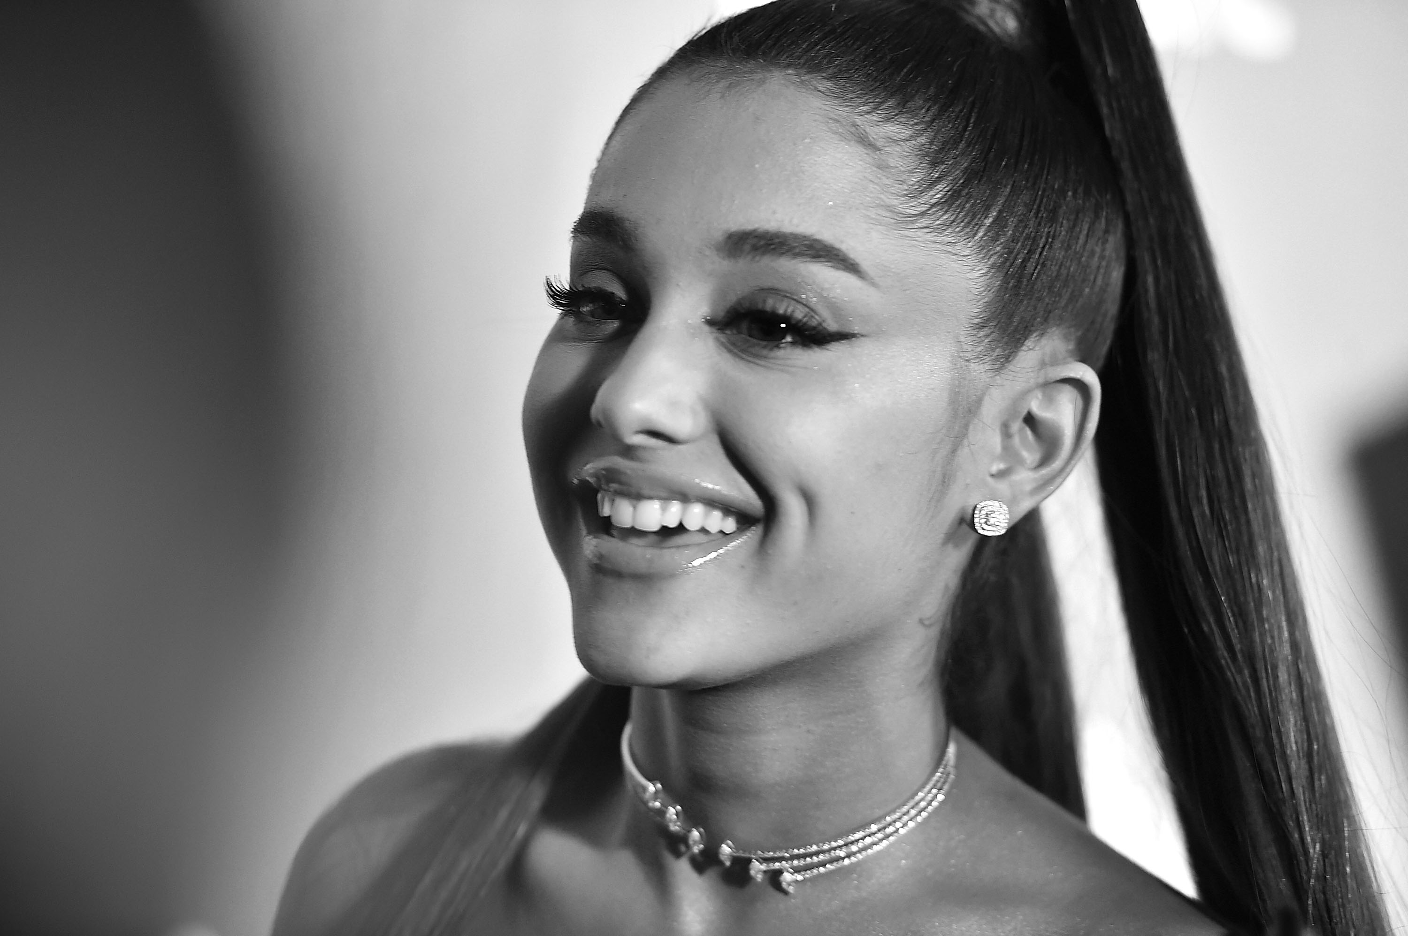
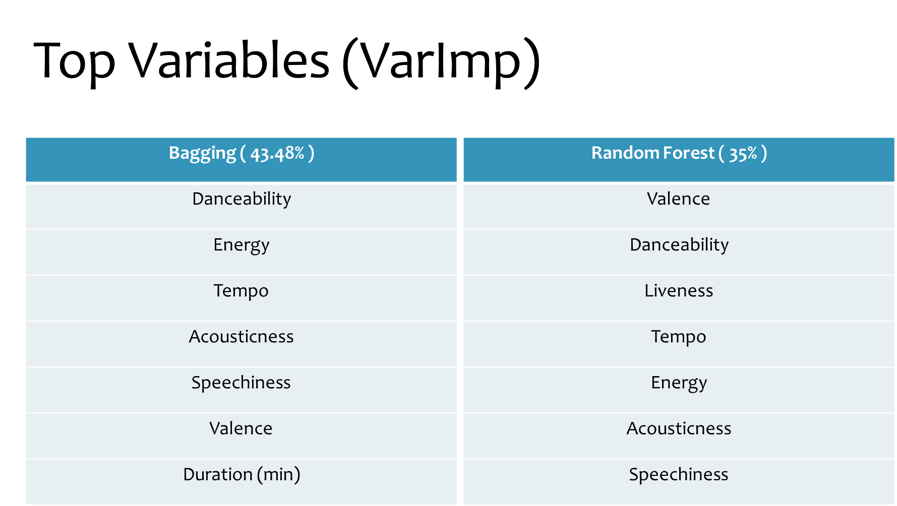
Seven Rings Variables

Slide 14
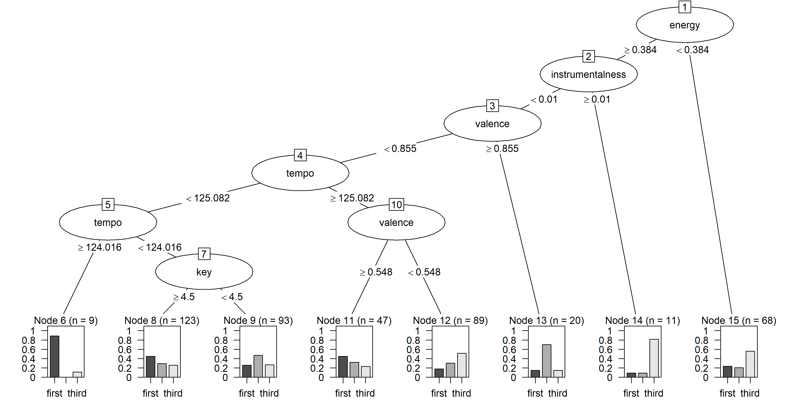
51.09% Accuracy

Slide 15
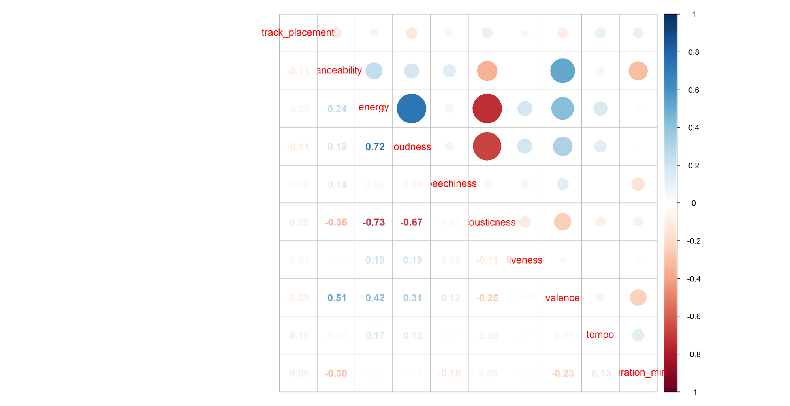
Correlation Plot
Correlation Plot

Slide 16
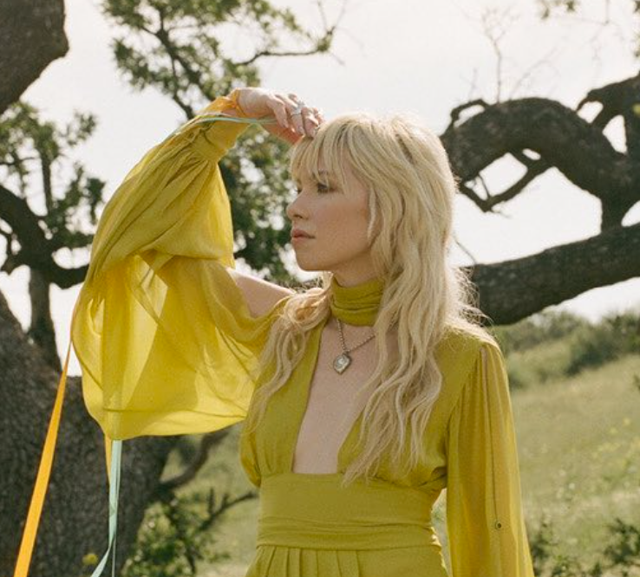
Classification Comparison
Method | % Correct (No Log) | % Correct (With Log)
Classification Tree (cp = .025) | 51.09% | 51.09%
QDA | 49.78% | 51.30%
Bagging | 43.48% | 44.13%
Naïve Bayes | 37.61% | 38.47%
Random Forest | 35% | 34.20%

Slide 17
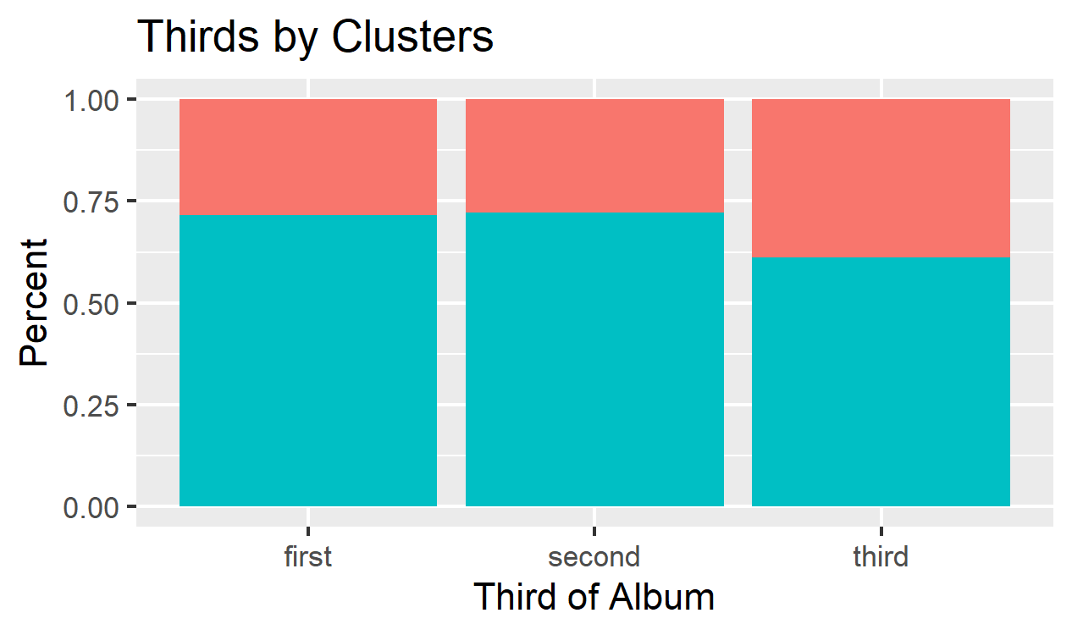
Clustering
Later songs look to be different
New variable “Third”
Cluster and Third – stat sig

Slide 18
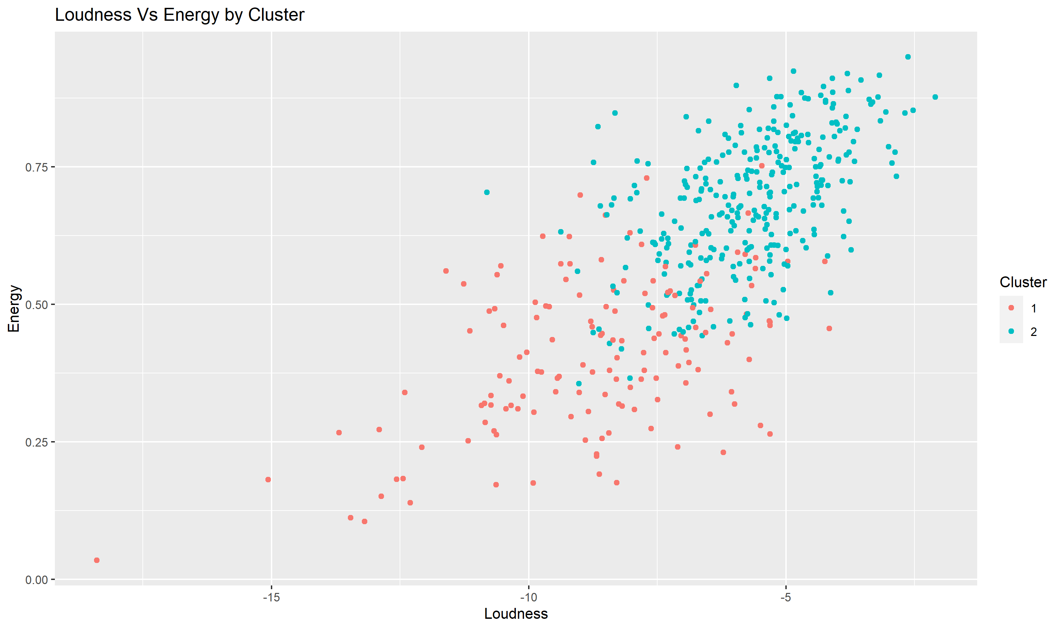
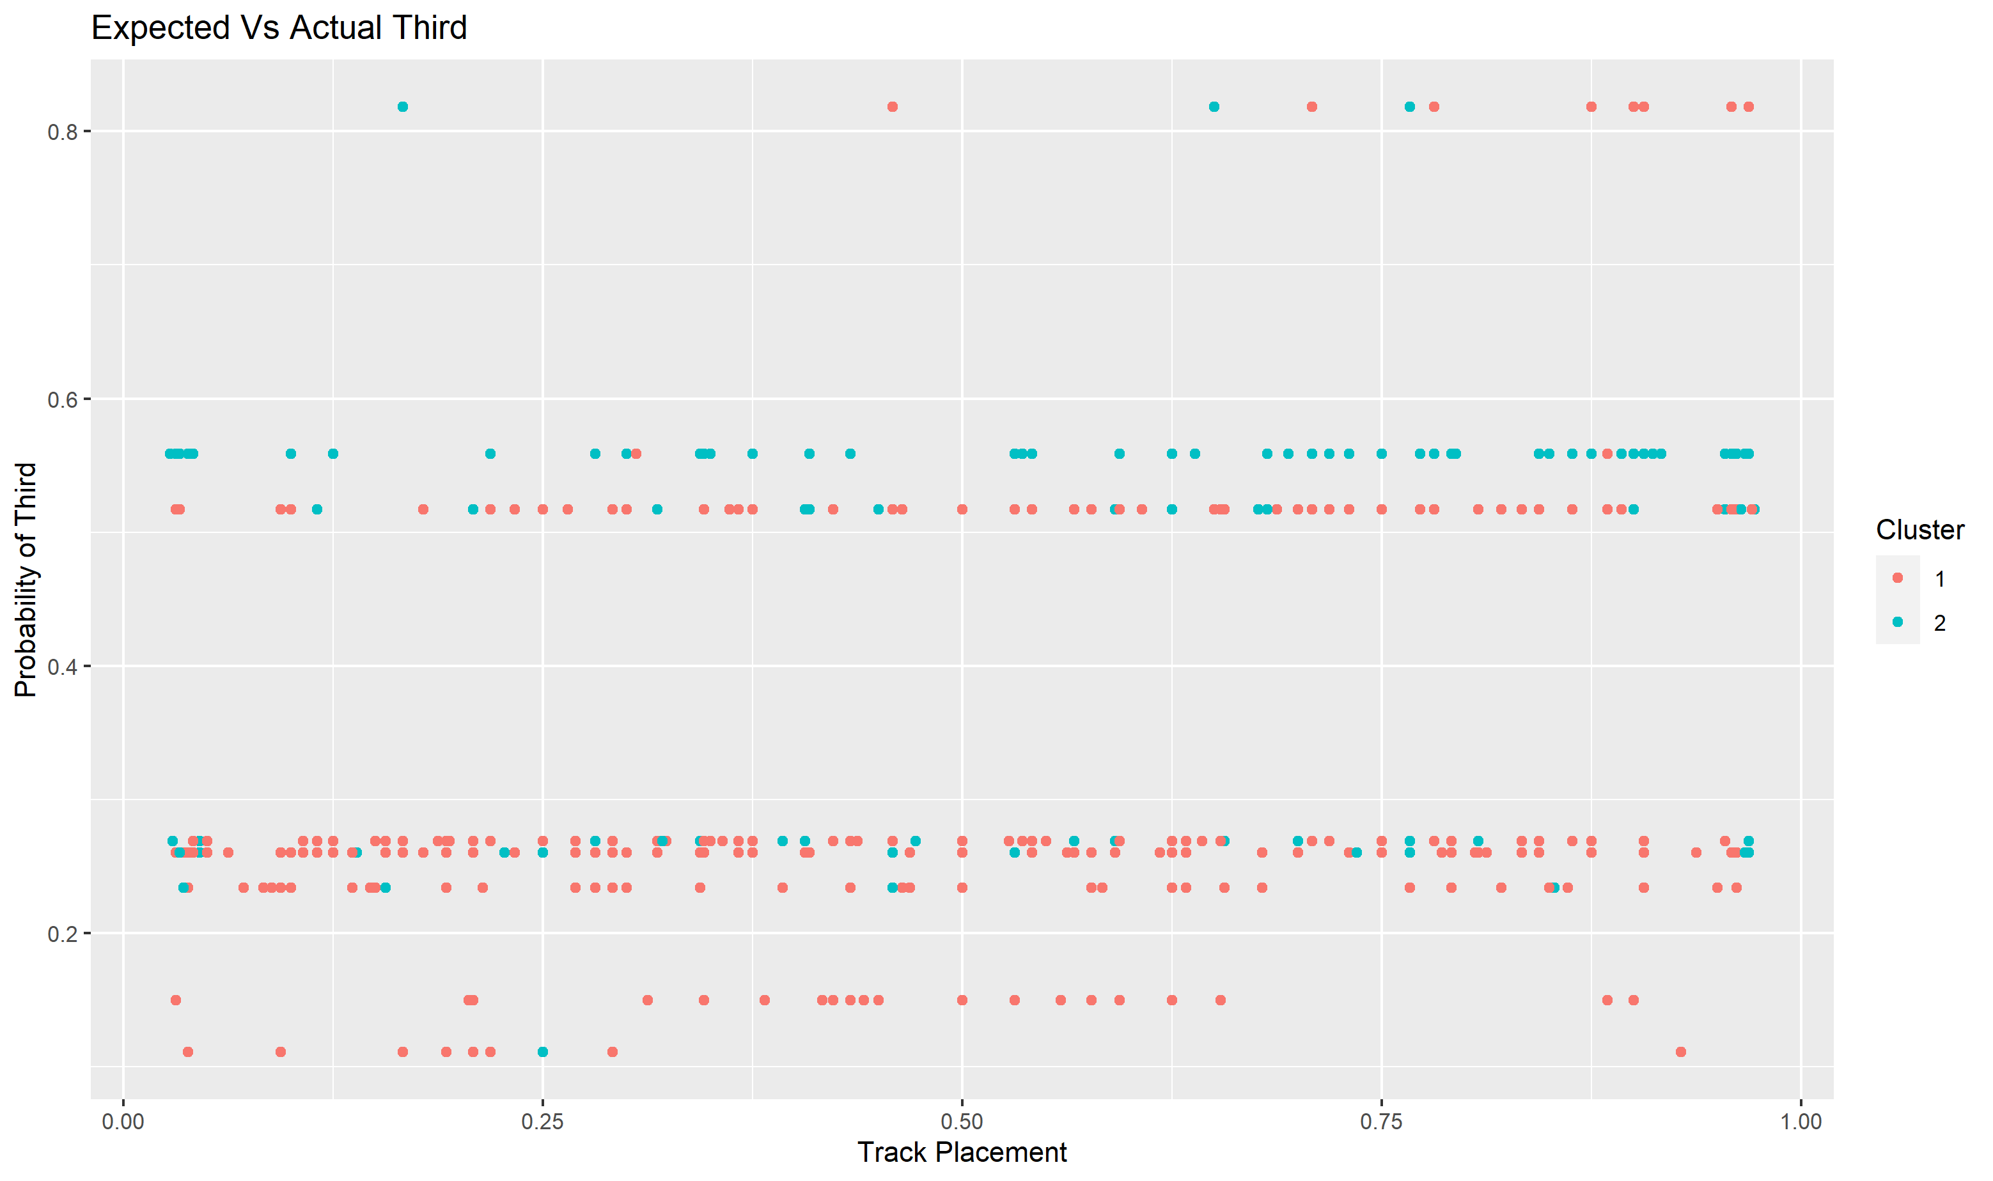

Slide 19

Future Nostalgia
Cleaning – duplicates
Calculating third
Log(instrumentalness)
Use Pop AOTY
Stabilize bagging and RF
Compare genres
K-Pop
Indie Pop
Rock

Slide 20


Slide 21

Grammy Analysis
Log(AOTY ) = 0.8311 – 1.4078*(valence)
AIC = 31.646
Log speechiness and liveness

Slide 22
